Slide 1

CSE 599 B1
Software Engineering for Data Scientists Introduction to Version Control
David Beck^{1,2}, Joseph Hellerstein^{1,3}, Jake VanderPlas^{1,4}
De Dennis Meng⁵ (TA)
¹eScience Institute
²Chemical Engineering
³Computer Science Engineering
⁴Astronomy
⁵Electrical Engineering
The University of Washington
January 4, 2016

Slide 2
Agenda
Review
Collaborating with GitHub
Conflicts
Submit your homework!
If time permits…
Branching and merging
2

Slide 3
Review
How do I...
view the change history for the repository?
see what files in the directory are modified from the last commit?
examine the changes between modified files and the last commit?
place a modified file into the staging area?
move the staged files into the repository history?
3

Slide 4
Review
What is...
the master branch?
HEAD?
HEAD~3?
4

Slide 5
Review
What do the following verbs do?
Push
Pull
Clone
5

Slide 6
Collaborating with GitHub
Last time...
Created a local repository
What command was that again?
Added some files, committed them
Linked the repository to the remote
What command was that again?
Nice remote backup, but…
6

Slide 7
Collaborating with GitHub
Today…
Pair up
Identify one of the pair to “own” the planets repository
Add the other of the pair as a collaborator to the repository
Both clone the planets repository
7

Slide 8
Collaborating with GitHub
Today…
Both make changes to mars.txt by adding a new line
Status, diff, add, commit, push
What happens?
8

Slide 9
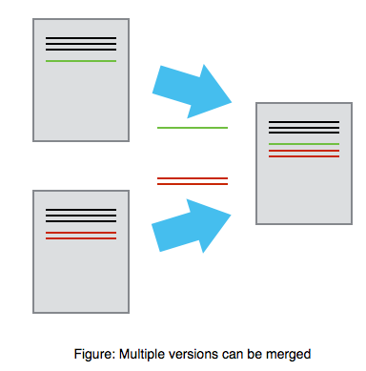
Mary
Alice
9

Slide 10
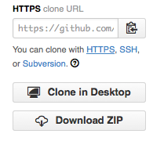
10

Slide 11
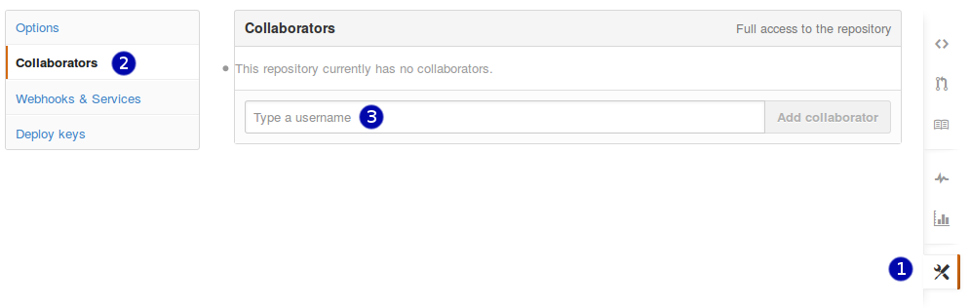
11

Slide 12
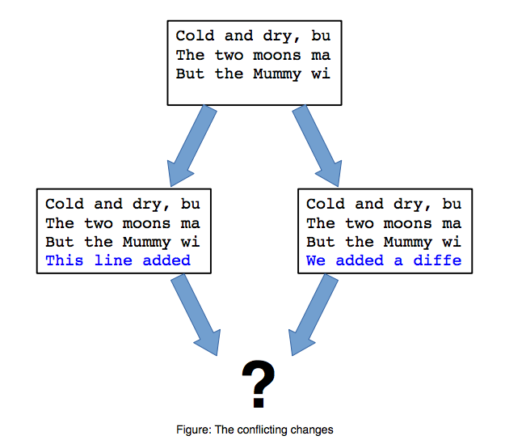
12

Slide 13
Master
C0
C1
C2
C3
C4
13

Slide 14
Master
C0
C1
C2
C3
C4
An issue is created in the tracker. We want to work on it but not in the main trunk that people might be downloading from GitHub.
14

Slide 15
Master
C0
C1
C2
C3
C4
Issue
We want to create a branch off our master and work in there. We’ll call the branch Issue.
15

Slide 16
Master
C0
C1
C2
C3
C4
C4
Issue
We make changes and commit them to the Issue branch.
16

Slide 17
Master
C0
C1
C2
C3
C4
C6
C5
Issue
Suppose simultaneously, we make a hot fix to Master and it gets a new commit.
17

Slide 18
Master
C0
C1
C2
C3
C4
C6
C5
Issue
We did some testing and C5 does indeed resolve the issue. Now we need to merge Issue back into Master.
18

Slide 19
Master
C0
C1
C2
C3
C4
C6
C6
C5
Issue
This takes some work on the part of git and we may have to manually resolve some conflicts. But the result is that we have a new commit that unifies Issue and Master, C7.
19

